Slide 1
Automating E-Commerce website using Selenium and Doker project
Name: Shaik Asia Begum
Employee ID:201325

Slide 2
Topics
Spring Boot
Selenium
Docker

Slide 3
Spring Boot
Spring Boot (Spring Boot) is a tool that makes developing web application and microservices with Spring Framework faster and easier
In short, Spring Boot is the combination of Spring Framework and Embedded Servers.
It creates stand-alone Spring applications that can be started using Java -jar.

Slide 4
Selenium
Selenium is one of the most widely used open source Web UI (User Interface) automation testing suite.
Selenium supports a variety of programming languages through the use of drivers specific to each language.
Selenium can be easily deployed on platforms such as Windows, Linux, Solaris and Macintosh. Moreover, it supports OS (Operating System) for mobile applications like iOS, windows mobile and android.

Slide 5
Docker
Docker is a software platform that allows you to build, test, and deploy applications quickly.
Docker packages software into standardized units called containers that have everything the software needs to run including libraries, system tools, code, and runtime.
Using Docker, you can quickly deploy and scale applications into any environment and know your code will run.

Slide 6
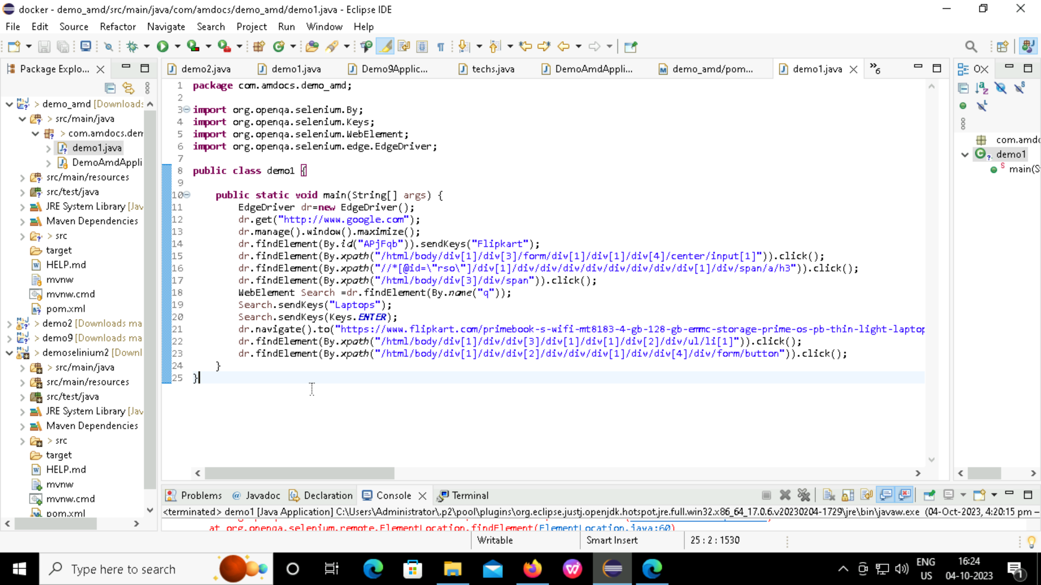
Code: Automating Flipkart using selenium

Slide 7
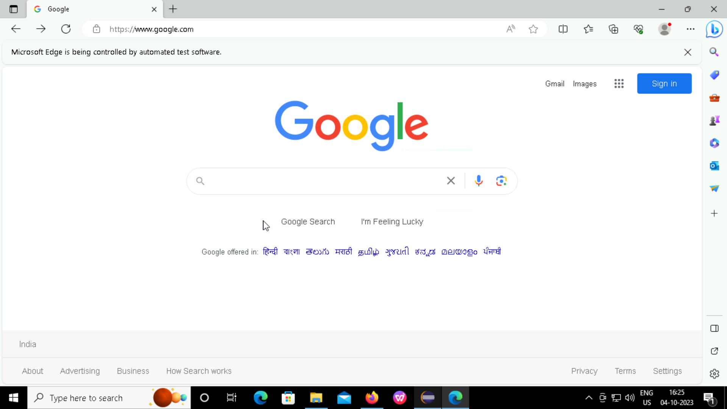
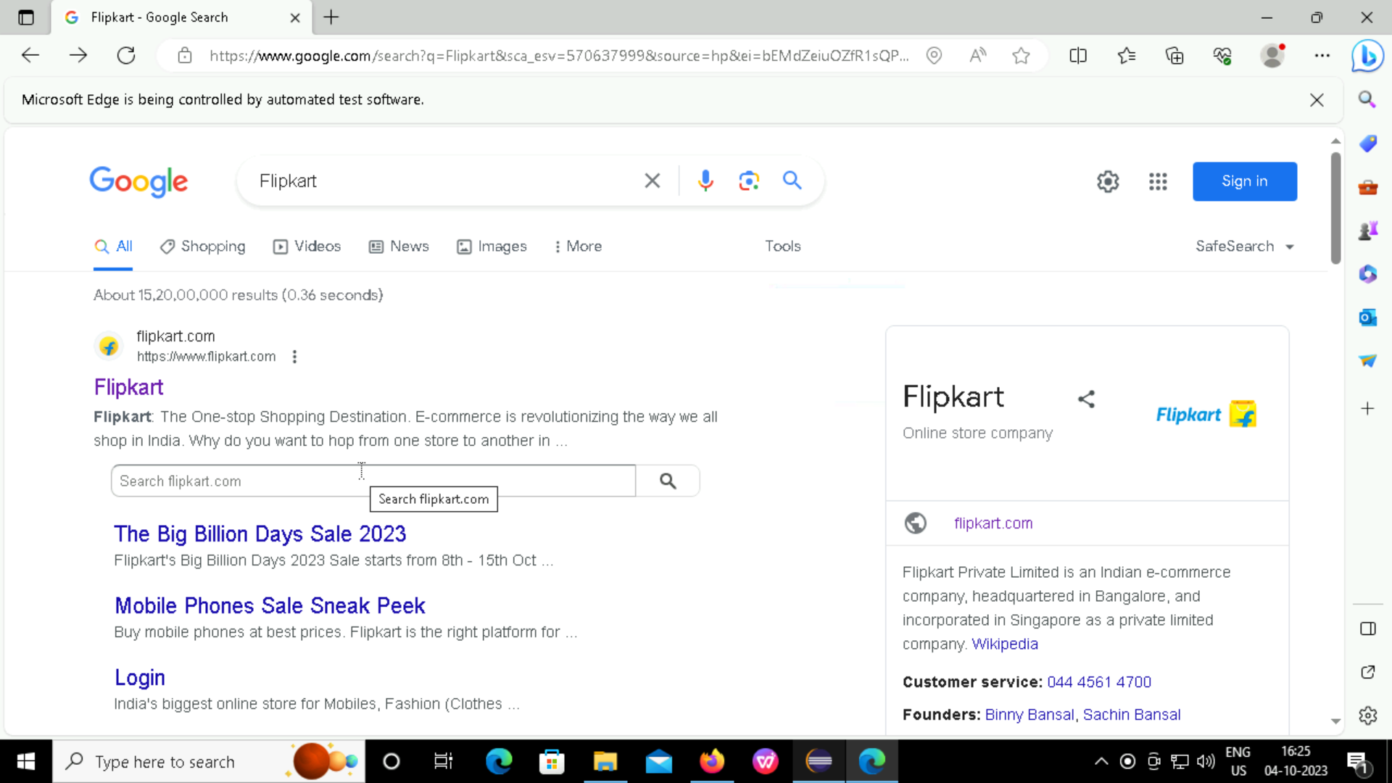
Output- 1,2

Slide 8
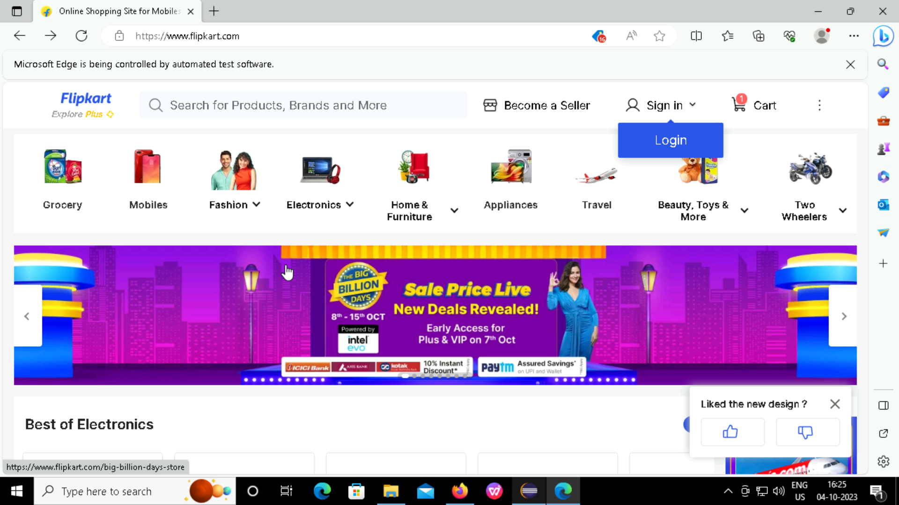
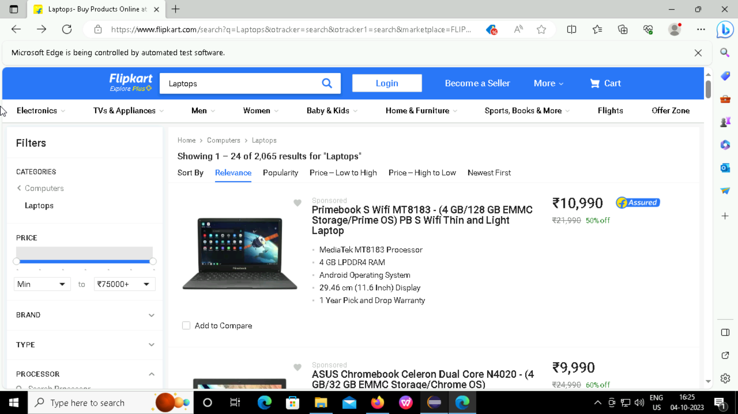
Output- 3,4

Slide 9
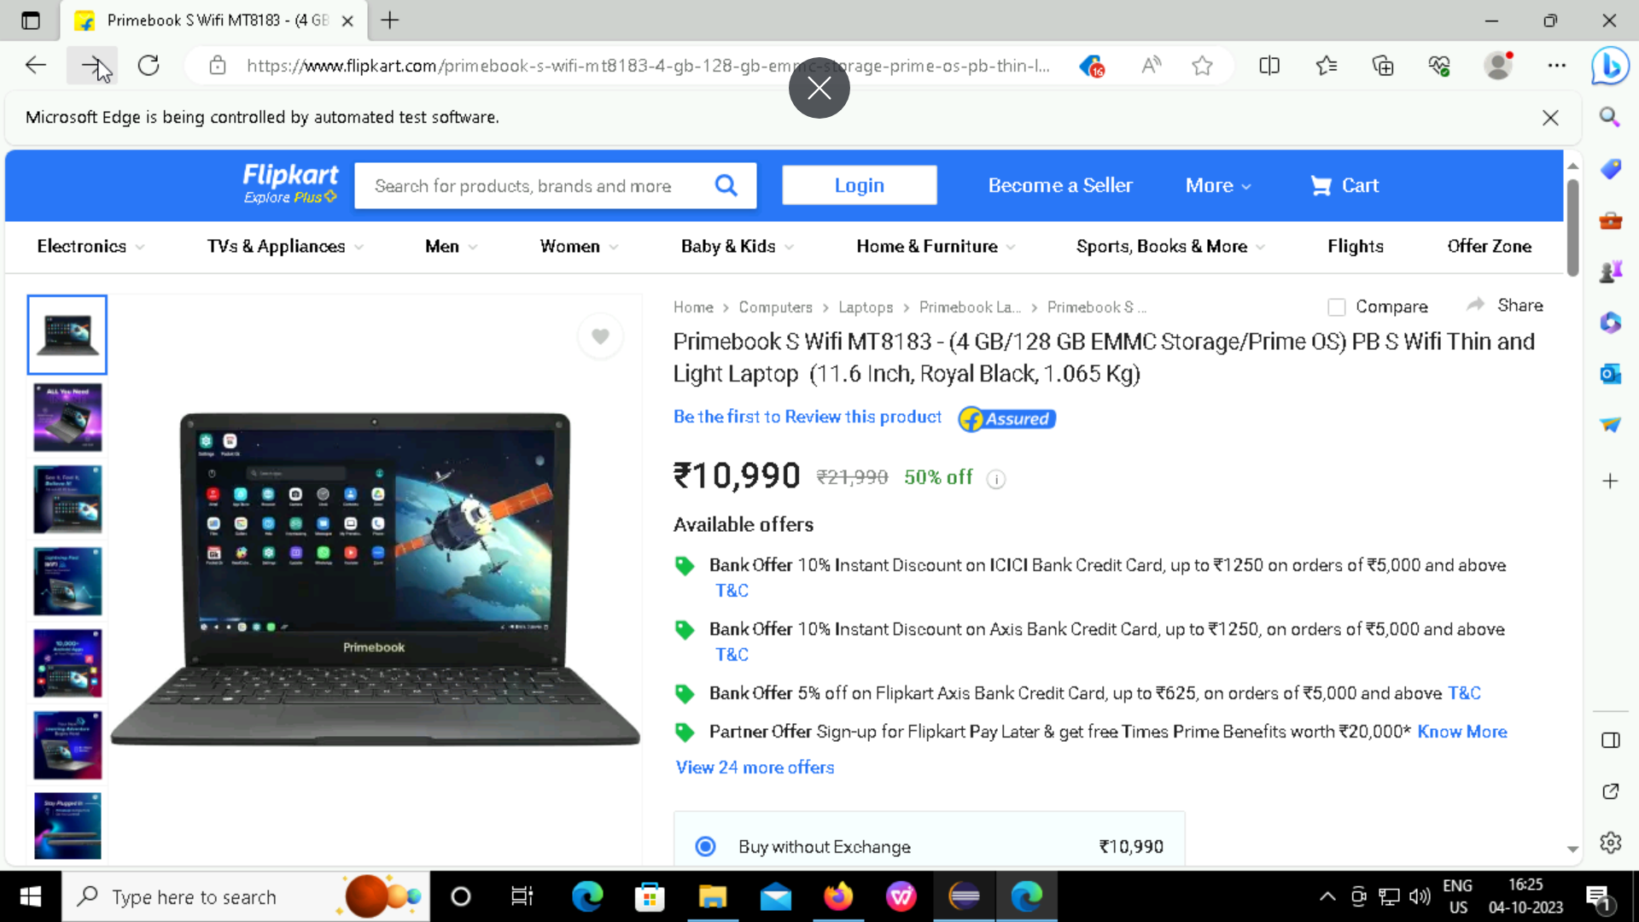
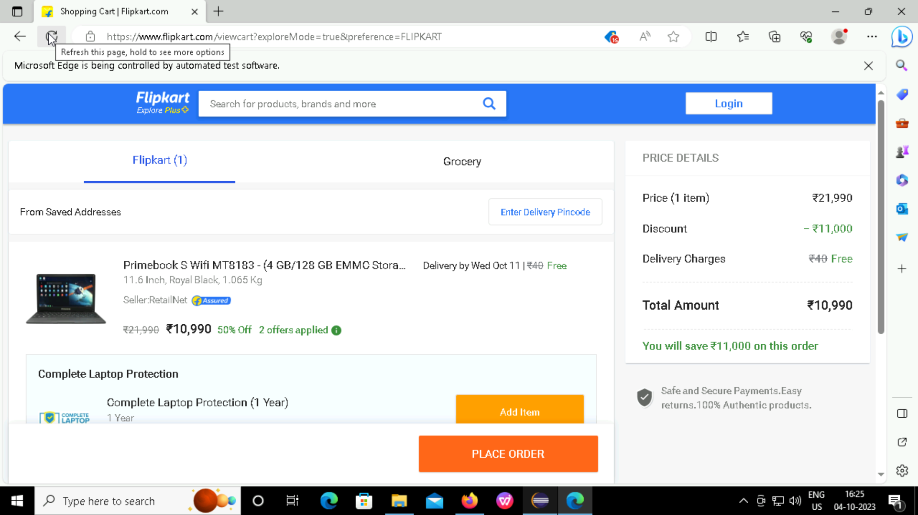
Output 5,6

Slide 10
Output-6

Slide 11
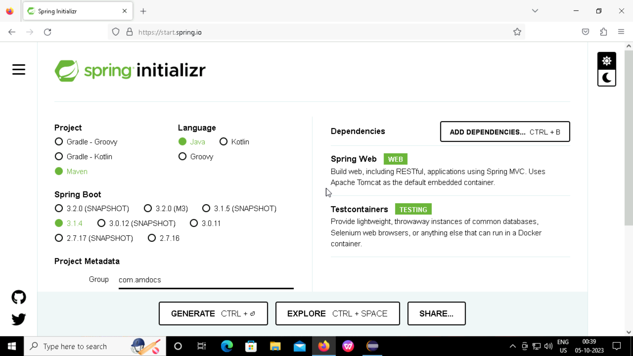
Creating spring boot project

Slide 12
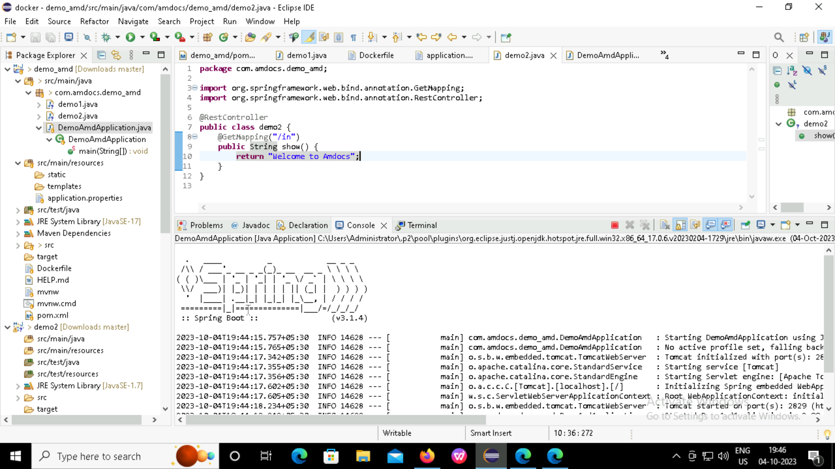
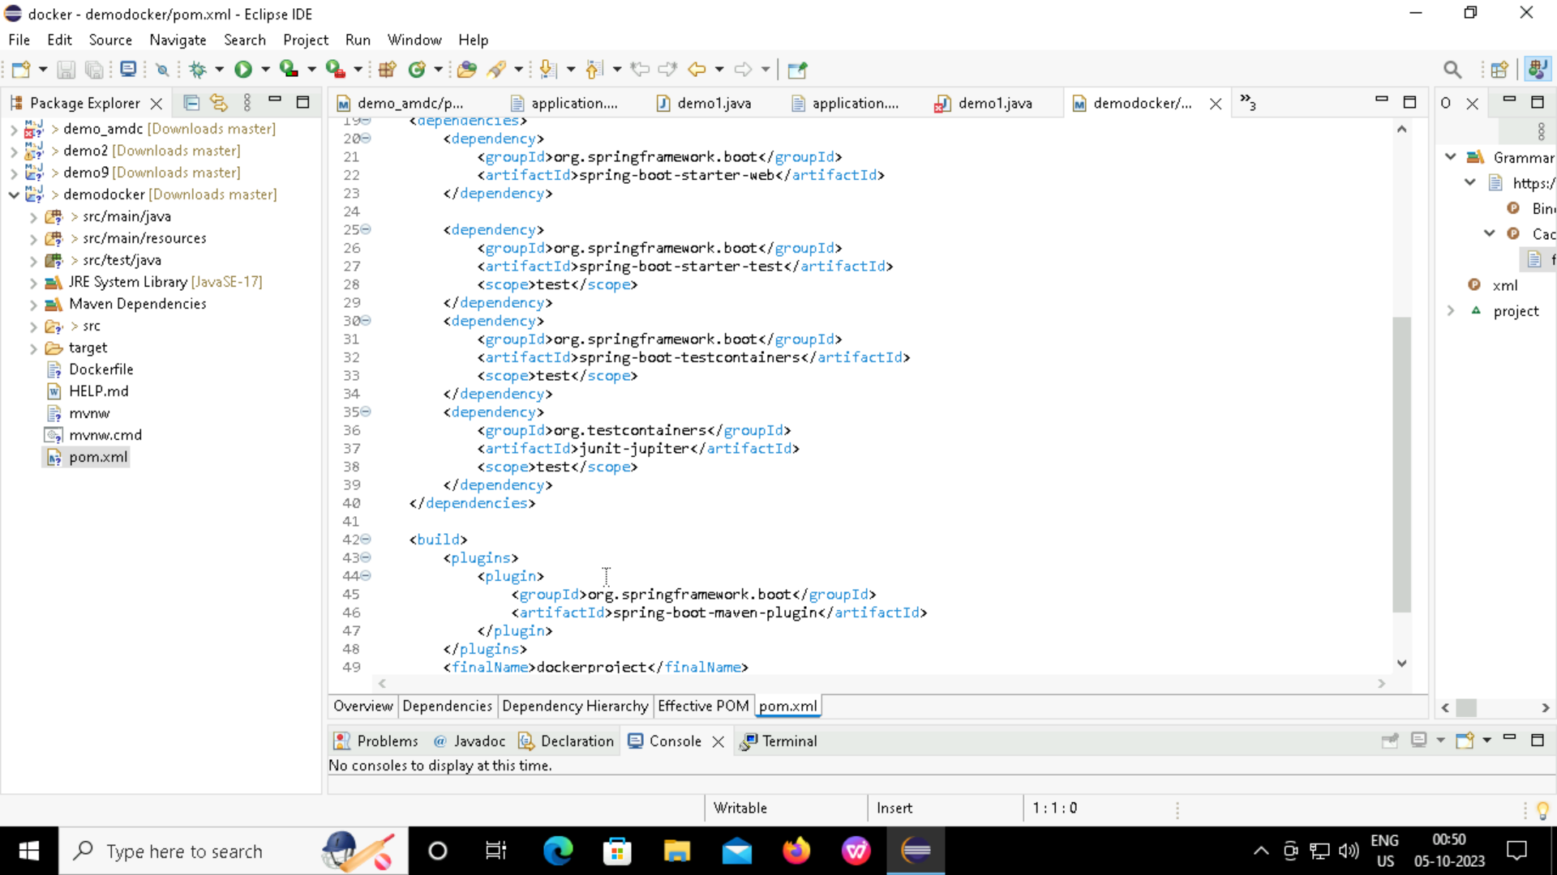

Slide 13
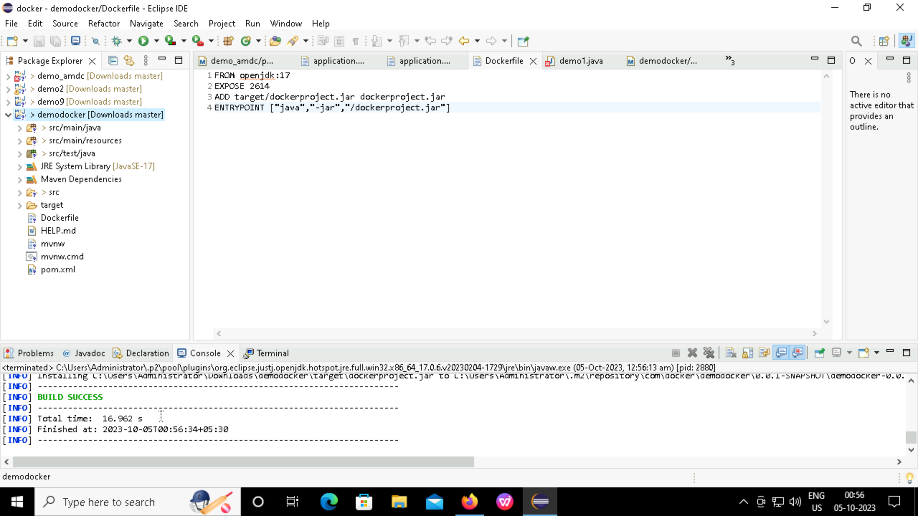

Slide 14
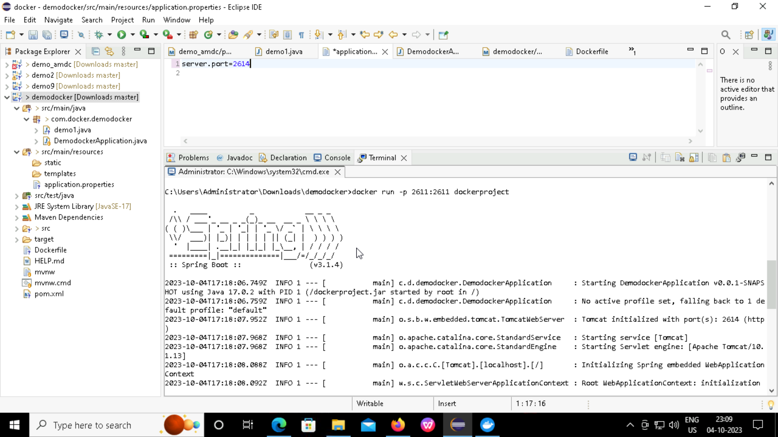
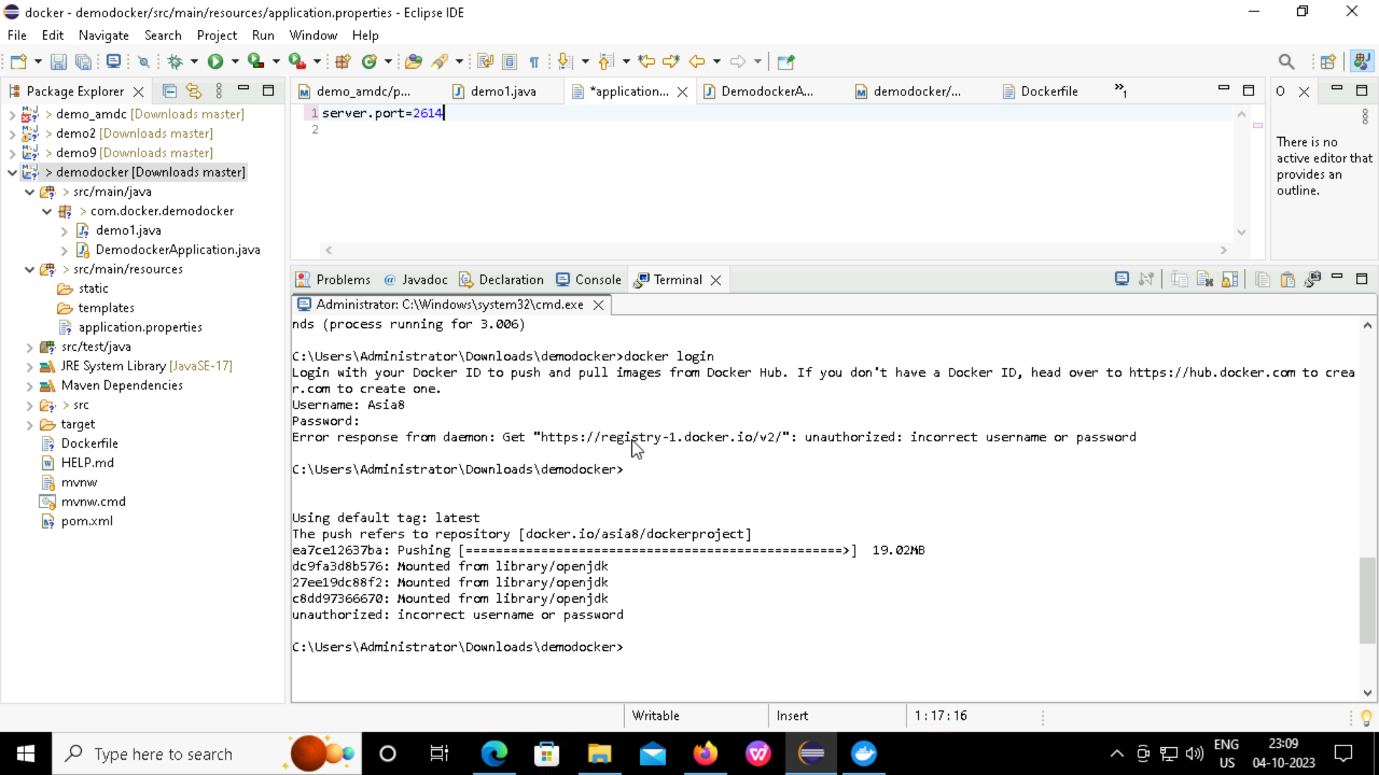
Creating Docker image & pushing in DockerHub

Slide 15
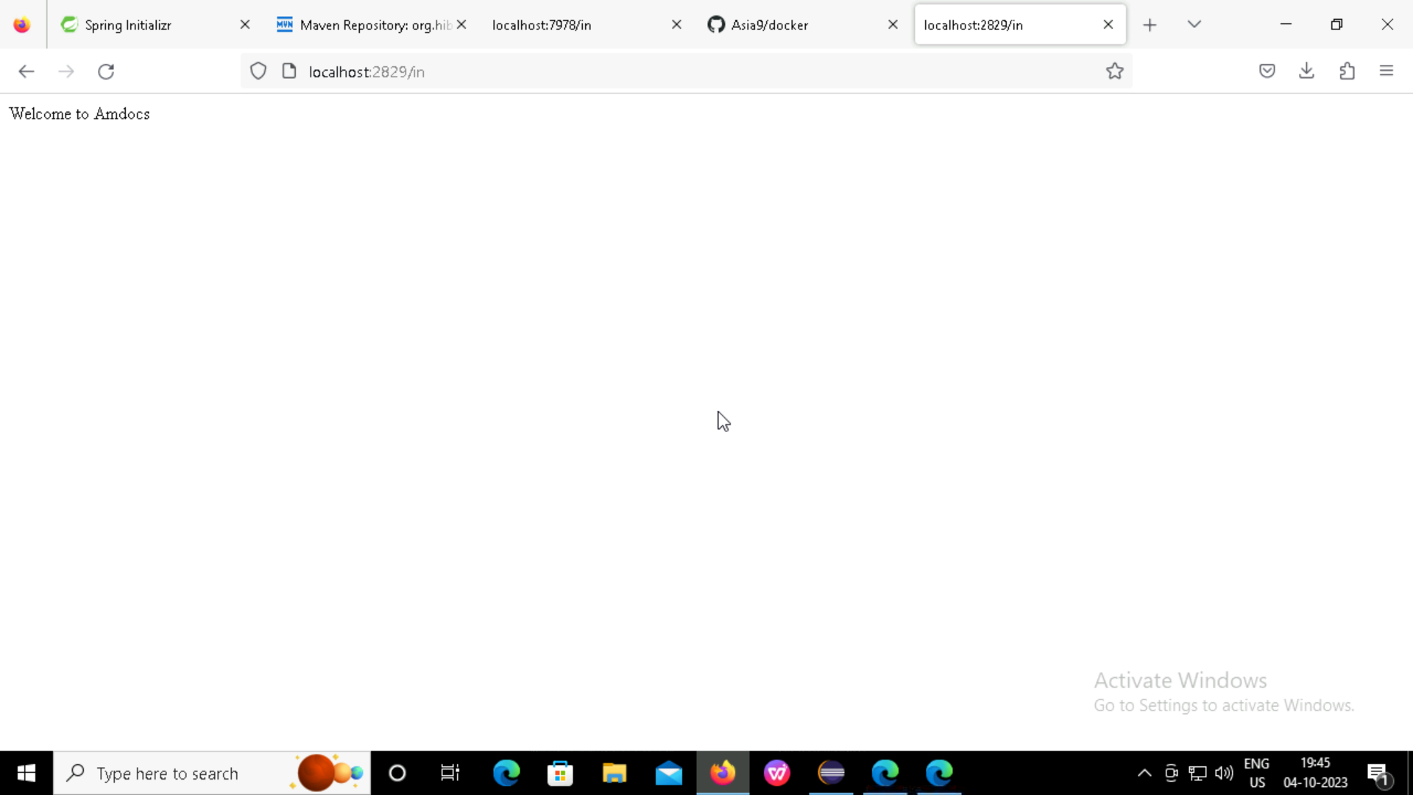

Slide 16
Thank you

